Slide 1
Introducing Angular

Slide 2
Introducing Angular
AngularJS was a frontend JavaScript framework designed to build single-page applications using an MVC-like architecture.
The Angular approach was to extend the functionality of HTML using special attributes that bind JavaScript logic with HTML elements.
AngularJS's ability to extend HTML allowed cleaner DOM manipulation through client-side templating and two-way data binding that seamlessly synchronized between models and views.
AngularJS also improved the application's code structure and testability using MVC and dependency injection.
AngularJS 1 was and still is a great framework, but it was built with the concepts of ES5 in mind, and with the huge improvements brought by the new ES2015 specification coming up, the team had to rethink the entire approach.

Slide 3
A TypeScript primer

Slide 4
Introduction to TypeScript
TypeScript is a typed programming language created by Microsoft, which uses the object-oriented foundations of C#, Java, and now ES2015.
Code written in TypeScript is transpiled into JavaScript code either in ES3, ES5 or ES2015 and can be run on any of the modern web browsers.
It is also a superset of ES2015, so basically, any JavaScript code is valid TypeScript code.
The idea behind this was to create a strongly typed programming language for big projects that will allow big teams to better communicate the interface between their software components.
As derived from its name, TypeScript has an optional type system that allows developers to enforce limits on their code in order to have better clarity.
Since a lot of the features in TypeScript were already implemented in ES2015, we'll touch a few basic features that we'll need and didn't get in the current specifications.

Slide 5
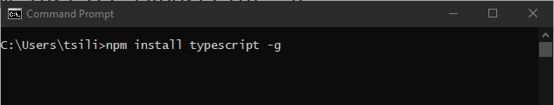
Installing TypeScript
Use a command prompt (or terminal window) to run the following command:
npm install typescript –g
Once the package has been installed, run the following command to ensure that the compiler was installed correctly:
tsc --version

Slide 6
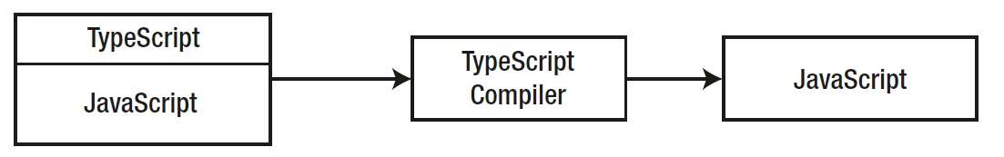
Understanding the TypeScript Developer Productivity Features
TypeScript’s headline features are focused on developer productivity, especially through the use of static types, which help make the JavaScript type system easier to work with.
Other productivity features, such as access control keywords and a concise class constructor syntax, help prevent common coding errors.
The TypeScript package includes a compiler that processes TypeScript files and produces pure JavaScript that can be executed by a JavaScript runtime, such as NodeJS or a browser.

Slide 7
Understanding the TypeScript Developer Productivity Features (continued)
The combination of JavaScript and TypeScript features retains much of the flexible and dynamic nature of JavaScript while constraining the use of data types, so they are familiar and more predictable for most developers.
It also means that projects that use TypeScript can still make use of the wide range of third-party JavaScript packages that are available, either to provide specific features or to embrace complete frameworks for app development (such as the React, Angular, and Vue.js front-end frameworks).

Slide 8
Understanding the TypeScript Developer Productivity Features (continued)
TypeScript features can be applied selectively, which means you can use only those features useful for a specific project.
If you are new to TypeScript and JavaScript, you are likely to start by using all of the TypeScript features.
As you become more experienced and your depth of knowledge increases, you will find yourself using TypeScript with more focus and applying its features just to the parts of your code that are especially complex or that you expect to cause problems.

Slide 9
Understanding the Limitations of the Productivity Features
Some TypeScript features are implemented entirely by the compiler and leave no trace in the JavaScript code that is executed when the application runs (e.g. TypeScript’s interfaces).
Other features are implemented by building on standard JavaScript and performing additional checks during compilation.
This means you often have to understand how a feature works and how it is implemented to get the best results, which can make TypeScript features seem inconsistent and arcane.

Slide 10
Understanding the Limitations of the Productivity Features (continued)
More broadly, TypeScript enhances JavaScript, but the result is still JavaScript, and development in a TypeScript project is largely a process of writing JavaScript code.
Some developers adopt TypeScript because they want to write web applications without learning how JavaScript works.
They see that TypeScript is produced by Microsoft and assume that TypeScript is C# or Java for web development, which is an assumption that leads to confusion and frustration.
It’s far better to understand the underpinnings of the TypeScript language, which is JavaScript.

Slide 11
Types
Types are a major part of every programming language, including JavaScript.
Unfortunately, static typing was not introduced in ES2015; however, TypeScript support the basic JavaScript types and also allows developers to create and use their own types.

Slide 12
Basic types
Types can be JavaScript primitive types, as shown in the following code:
let firstName: string = "John";
let lastName = 'Smith';
let height: number = 6;
let isDone: boolean = false;
Moreover, TypeScript also allows you to work with arrays:
var numbers: number[] = [1, 2, 3];
var names: Array<string> = ['Alice', 'Helen', 'Claire'];
Both ways are then transpiled into the familiar JavaScript array declaration.

Slide 13
The any type
The any type represents any freeform JavaScript value.
The value of any will go through a minimal static type checking by the transpiler and will support all operations as a JavaScript value.
All properties on an any value can be accessed, and an any value can also be called as a function with an argument list.
Actually, any is a supertype of all types, and whenever TypeScript cannot infer a type, the any type will be used.
You'll be able to use the any type either explicitly or not:
var x: any;
var y;

Slide 14
Interfaces
As TypeScript is about keeping the structure of your project, highly important parts of the language are interfaces.
An interface allows you shape your objects and keep your code solid and clear.
Classes can implement interfaces, which means that they will have to conform to the properties or methods declared in the interface.
Interfaces can also inherit from other interfaces, which means that their implementing classes will be able to implement the extended interfaces.
An example TypeScript interface will look similar to this:
interface IVehicle {
wheels: number;
engine: string;
drive();
}

Slide 15
Interfaces (continued)
Here, we have an IVehicle interface with two properties and one method.
An implementing class would look like this:
class Car implements IVehicle {
wheels: number;
engine: string;
constructor(wheels: number, engine: string) {
this.wheels = wheels;
this.engine = engine;
}
drive() {
console.log('Driving...');
}
}
As you can see, the Car class implements the IVehicle interface and follows the structure set by it.

Slide 16
Decorators
While it's still in the proposal stage for the new ES7 specifications, Angular relies heavily on decorators.
A decorator is a special kind of declaration that can be attached to various entities, such as classes, methods, or properties.
Decorators provide developers with a reusable way to annotate and modify classes and members.
A decorator uses the @decoratorName form, where the decoratorName parameter must be a function that will be called at runtime with the decorated entity.
A simple decorator would look as follows:
function Decorator(target: any) {
}
@Decorator
class MyClass {
}

Slide 17
Decorators (continued)
At runtime, the decorator will be executed with the target parameter populated with the MyClass constructor.
Moreover, the decorator can also have arguments as follows:
function DecoratorWithArgs(options: Object) {
return (target: Object) => {
}
}
@DecoratorWithArgs({ type: 'SomeType' })
class MyClass {
}
This pattern is also know as a decorator factory.

